Slide 1
Welcome to Citrix ShareFile!
Please access Citrix ShareFile through the link below:
https://cypruscreditunion.sharefile.com/dashboard

Slide 2
Why Citrix?
Here at Cyprus, we care about the safety of our member’s information. In order to prevent any issues and securely send AND receive information, we have decided to begin using Citrix ShareFile. This will be used EVERY SINGLE TIME you send or receive a document or screenshot.
Everyone needs to swap completely over to Citrix ShareFile by the end of February. As of March 1st, you cannot send or request any documents through Outlook.
Even though it’s a bit scary to use a new system, trust me when I say that this system will be really good to use, especially for sending multiple documents at the same time.

Slide 3
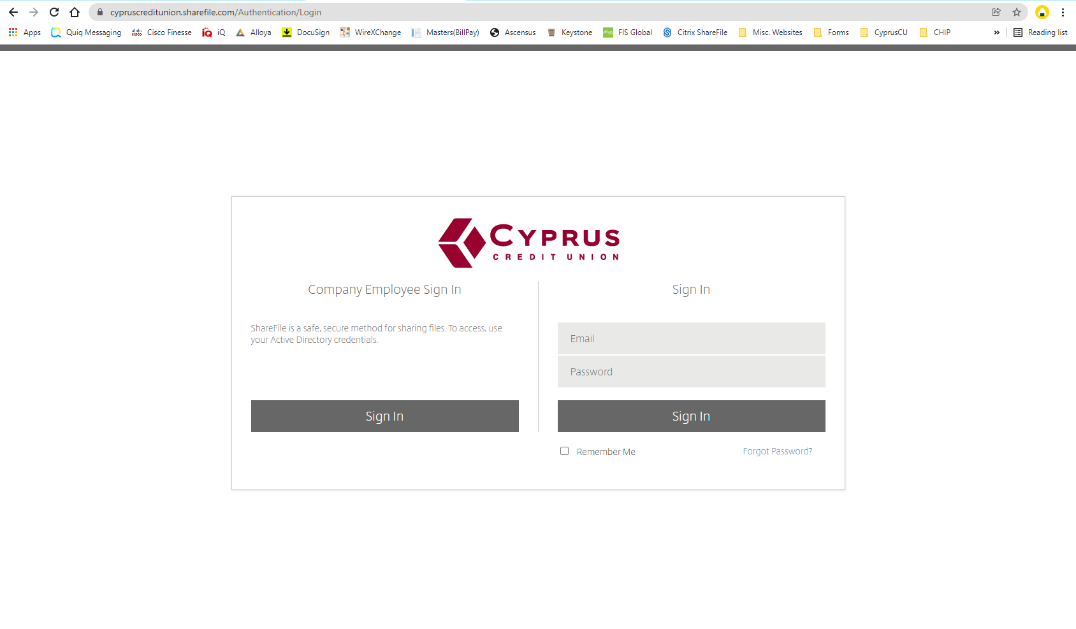
Notes:
Citrix ShareFile should be single sign on, so you will just need to click “Sign In” on the left side and it should log you straight in.

Slide 4
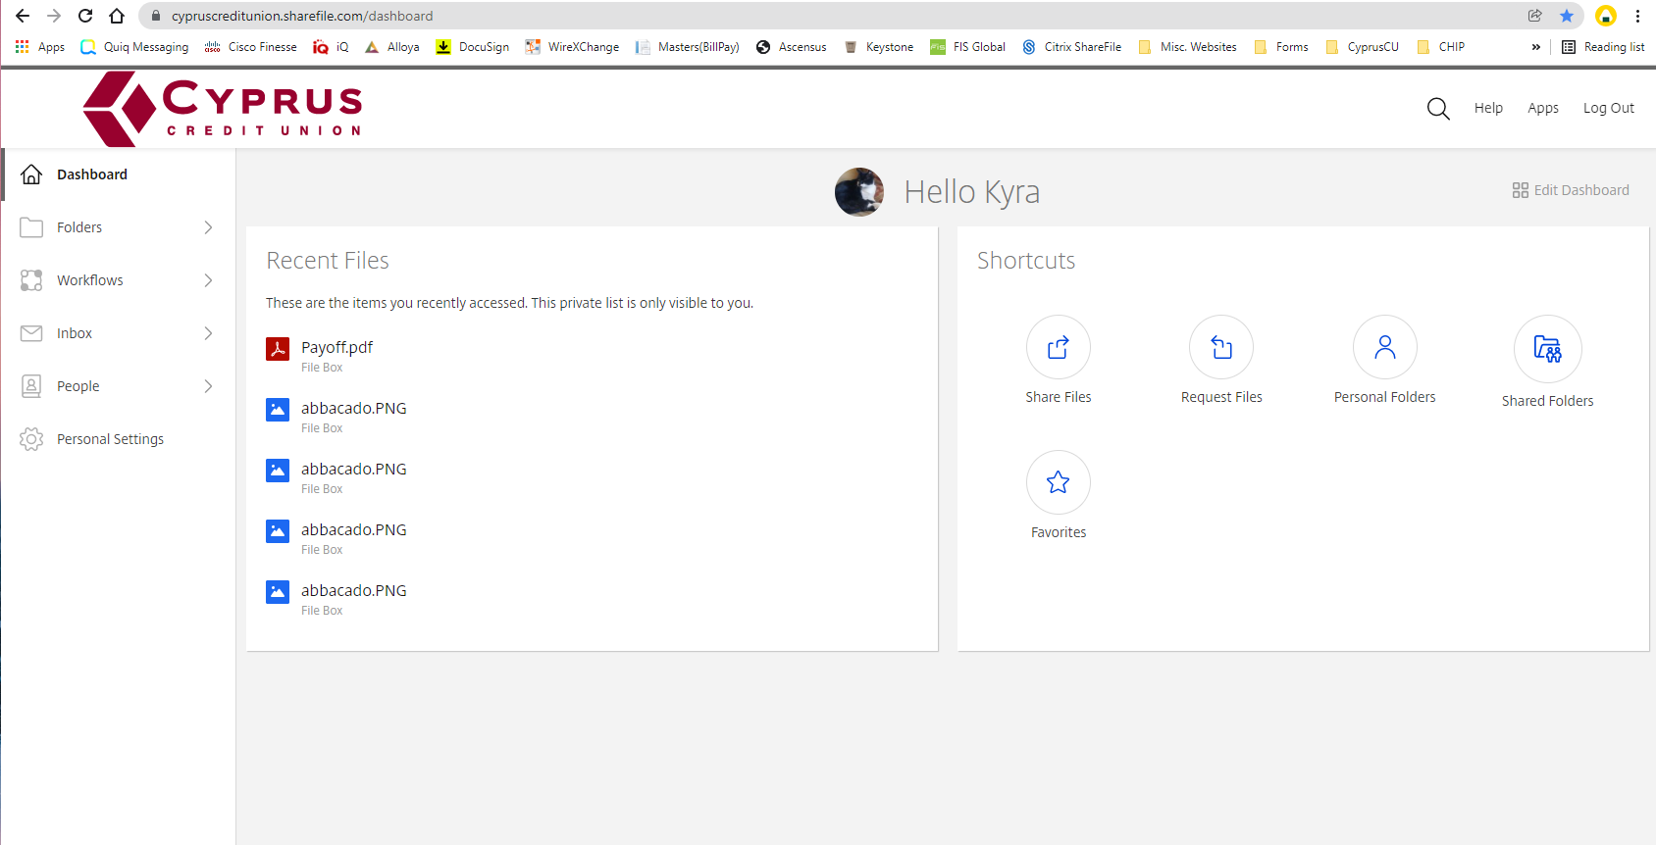
Notes:
This is the main screen that you should see when you log in.
You can always return here by clicking “Dashboard”.
The next tab is “Folders”, this is where you can access and upload your documents.
The final tab we will use is the “Inbox”. This is where you can see everything you have sent and edit or resend them if you need to.
On your dashboard you should have a “Recent Files” section which will show you the 5 most recent sent items.
And to the right of that, you can see your “Shortcuts” section which is the quickest way to send and request files.
Firstly we are going to talk about the “Share Files” option which is used for sending documents!

Slide 5
Sending Files!

Slide 6
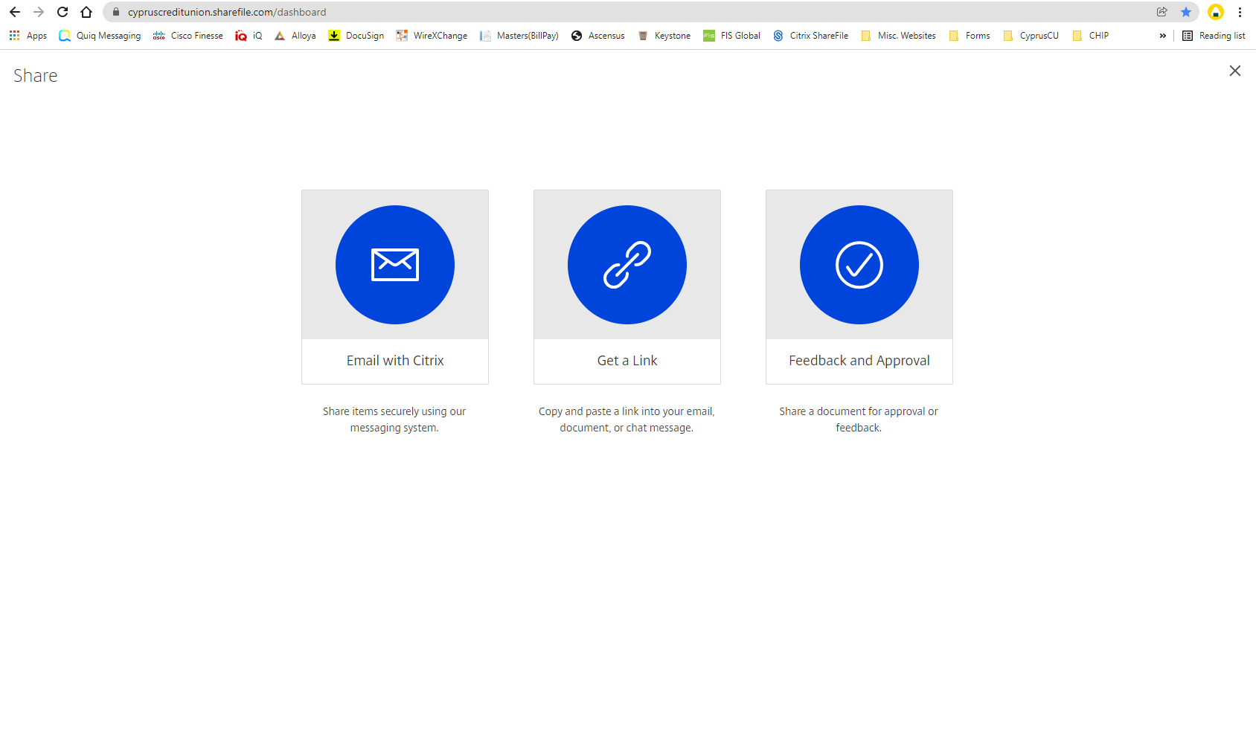
Notes:
Once you have clicked on the “Share Files” shortcut, you should see this page. There are two options to send documents and which of these you use depends on whether or not you are going to be sending the forms secure.
If you are going to send the documents secure, you will want to choose the “Email with Citrix” option.
If you are not going to send the documents secure, you will want to choose the “Get a Link” option.
We will never use the “Feedback and Approval” option.
For now, we are going to focus on the “Email with Citrix” option which is what we should use in order to send secure documents.

Slide 7
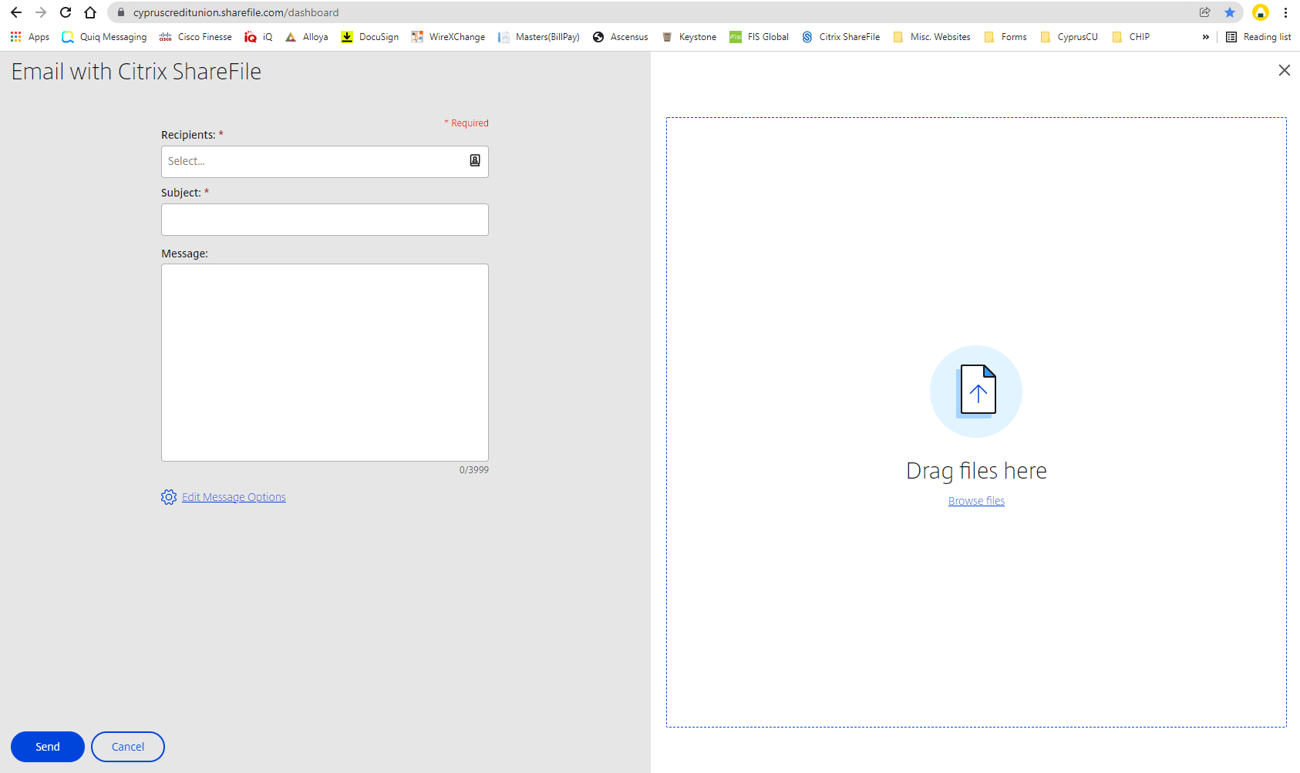
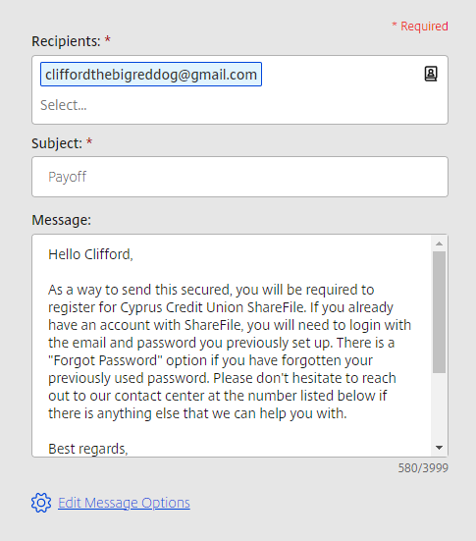
Hello (BLANK),
In order to the secured information, you will be required to register for Cyprus Credit Union ShareFile before you can download the document(s). If you already have an account with Cyprus Credit Union ShareFile, you will need to login with the email and password you previously set up. There is a "Forgot Password" option if you have forgotten your password. Please don't hesitate to reach out to our contact center at the number listed below if there is anything else that we can help you with.
Best regards,
(YOUR NAME)
(YOUR TITLE)
Email: (YOUR EMAIL)
Phone: 801-260-7600
Fax: 801-260-7904
Notes:
Once you have clicked on it, you should see this screen.
This is where you will put in the recipients email, compose the subject and message.
And this is where you will include the files.
Here is an example of what it should look like. I recommend including a small message about the system and your contact information.
This is what I have saved to send with anything I send secured. Please take this and use it for your secured emails. You will want to adjust the name, title, and email, and you can make any additional changes to the message as need be.

Slide 8
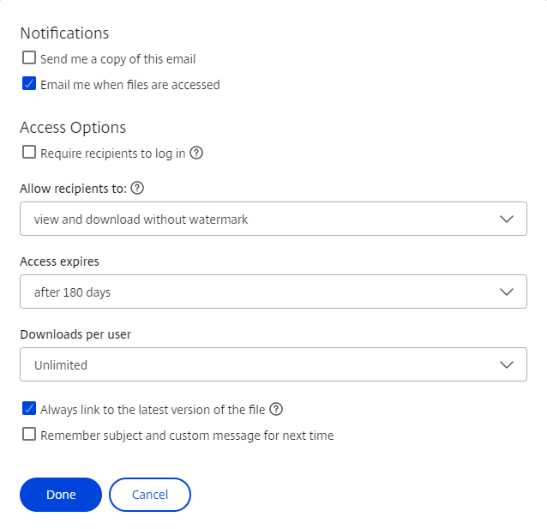
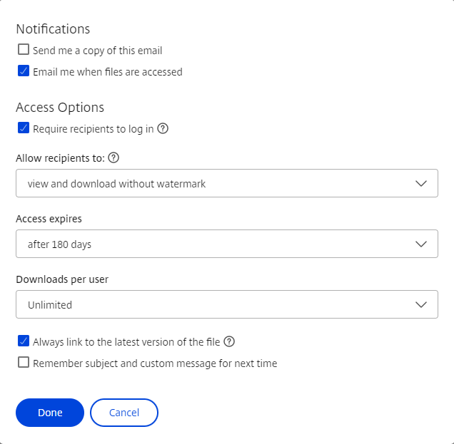
Notes:
After you have filled out the required bits of information to the left, you will need to click the “Edit Message Options”.
This screen should pop-up. The first time you ever use the “Email with Citrix” option, the setting for “Require recipients to log in” should be unchecked.
You will want to check this then hit done. This requires the member to register and/or sign into a Cyprus Credit Union ShareFile account.

Slide 9
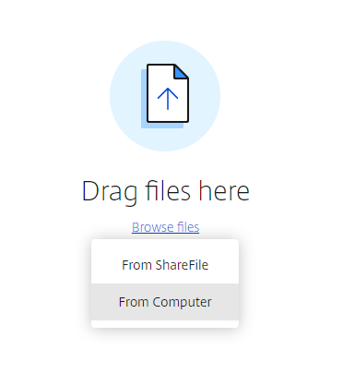
Notes:
After all of that is done, you will want to attached your files! To do this, click on the “Browse Files” option on the right side.
If you already have the file in your ShareFile folder you can choose ShareFile, but otherwise you will need to choose “From Computer” and then find and upload your documents. As far as I am aware, there is no limit on documents. I have sent nearly 200 statements at the same time using Citrix ShareFile.

Slide 10
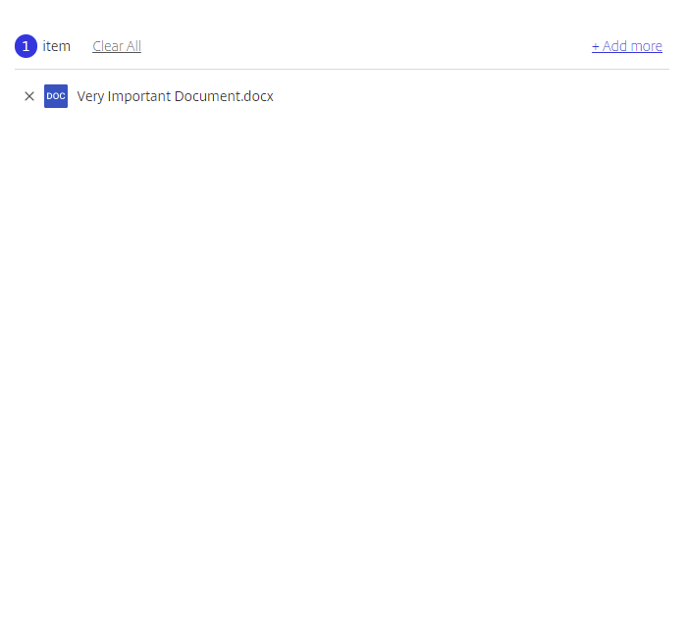
Members will be able to see the name’s of your documents! Please don’t name your document anything silly. And please don’t send the member a document with their account number in the name!
Notes:
All of the documents you are trying to send should show up and you can delete any if you need to.
Members will be able to see the name’s of your documents! Please don’t name your document anything silly. And please don’t send the member a document with their account number in the name!
Then you hit send! And viola! You have sent your secure email!

Slide 11
Notes:
Now, going back to our ways to send files, lets talk about the second option, getting a link. If you choose this option, you will still have to send your email through Outlook, but you can upload all the documents here.

Slide 12
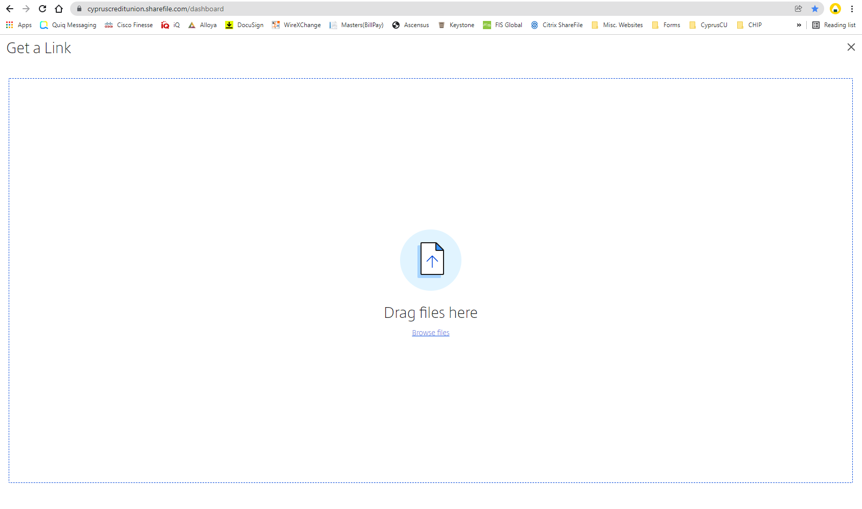
Notes:
You’ll notice that unlike the “Email” option, there is no spot to enter the recipients information. Instead, all you have to do is upload the documents.
So just like before, you click “Browse Files”
> From Computer and choose the documents you wish to send.

Slide 13
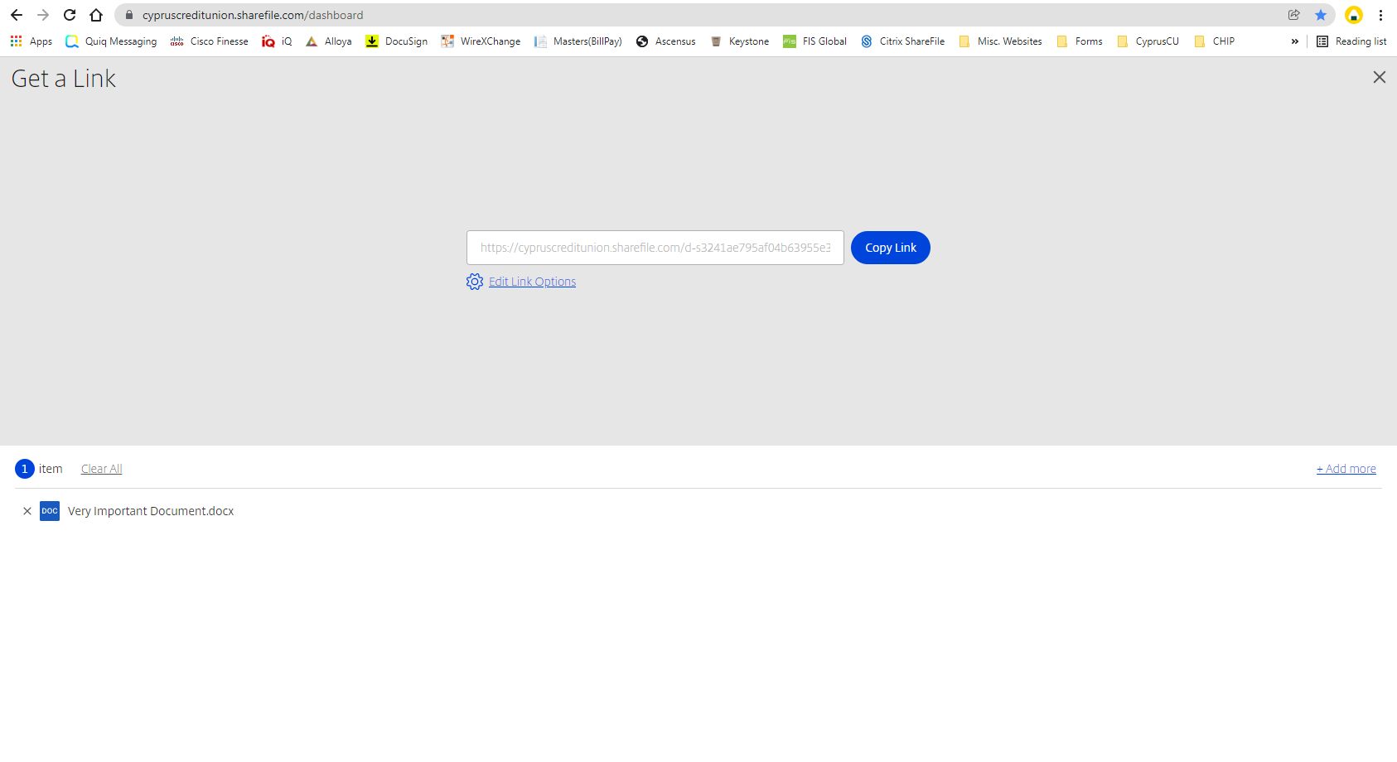
Notes:
Once you have all the documents that you want to send uploaded, a link should automatically generate.
Hit “Copy Link” and the link will be copied to your clipboard.

Slide 14
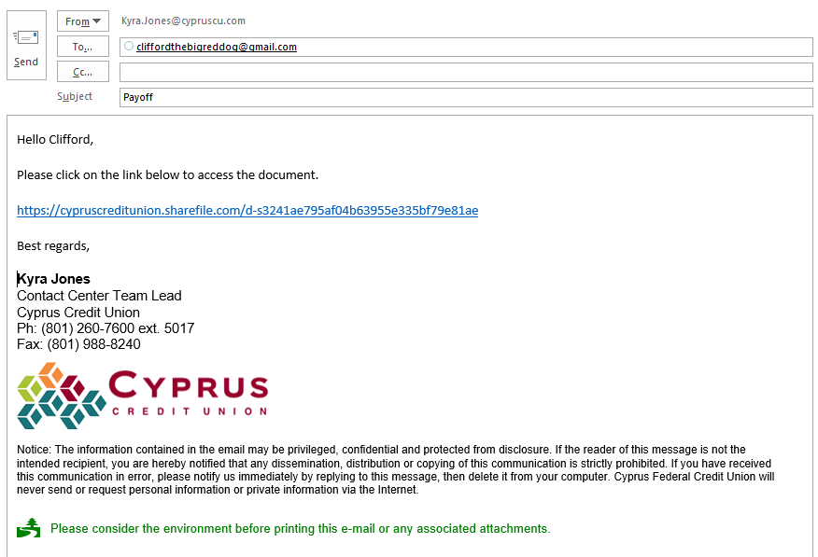
Notes:
Then you can include the link in an email to your member. This link will not require the member to sign in so you can send documents that don’t need to be secured.

Slide 15
Quiz! Which of the following should be sent secure and which of the following doesn’t have to be sent secure?
Official Cyprus statements
Payoff with account number showing
Letterhead without any sensitive information
Blank direct deposit form
Payoff with account number completely crossed out
Tax forms
Letterhead with account number
Filled out direct deposit form

Slide 16
Receiving Files!

Slide 17
Notes:
Next we are going to talk about requesting documents from our members.
Going back to the dashboard we will click on “Request Files”.

Slide 18
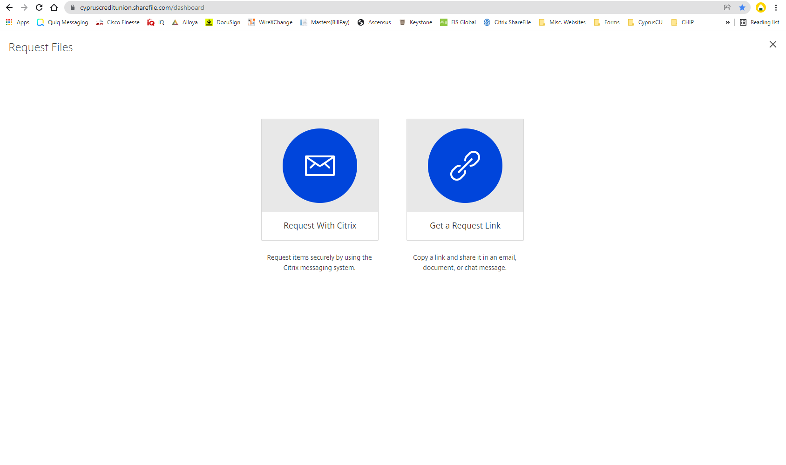
Notes:
This screen should pop up.
The first option “Request with Citrix” will not be used.
The second option “Get a Request Link” is what we will use to receive pretty much every document from our members. It is vitally important that you use this option for every single wire to get the wire instructions!! This is the main reason we are moving to this system! Now let’s talk about the “Get a Request Link” option. If you choose this option, you will still have to send your email through Outlook, but the member will upload all the documents to Citrix ShareFile.

Slide 19
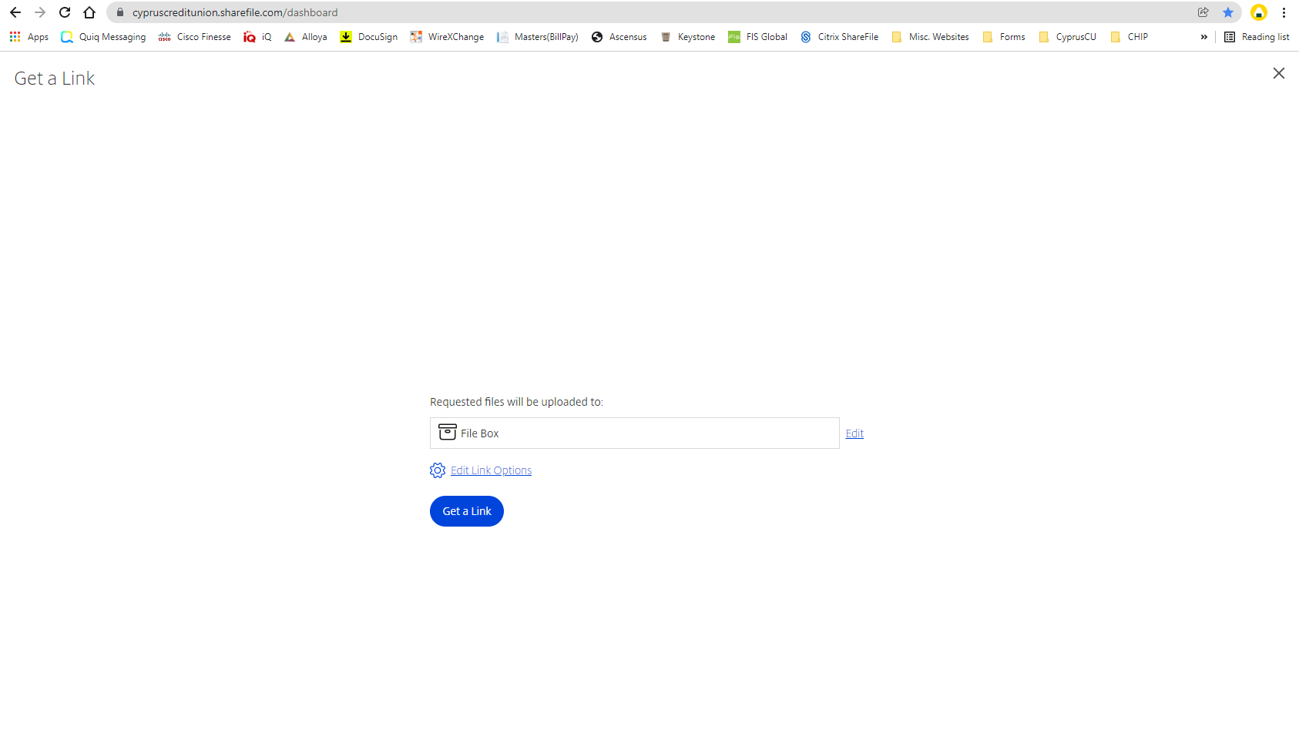
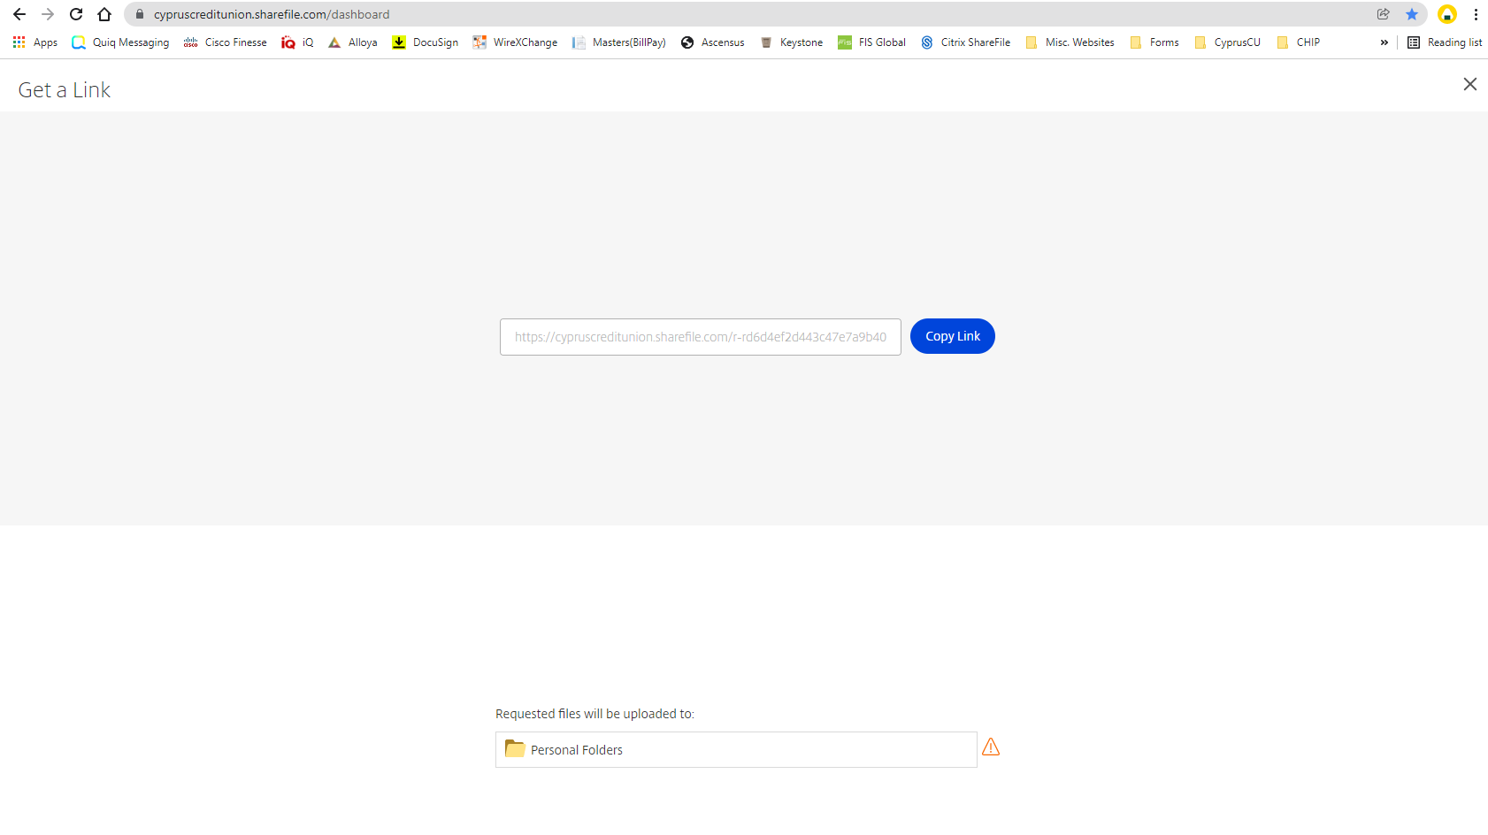
Notes:
For this, all you have to do is choose where you want the files to be uploaded to. The preset should be “File Box” and that’s completely fine to save your documents to, BUT anything saved in there has an expiration of 180 days. So if you have something you want to be able to save permanently, you will want to save it to “Personal Folders”.
To do this, you can click “Edit” and choose the folder you want to use.
Then click “Get a Link”

Slide 20
Notes:
You should get something that looks similar to the following.
Click on “Copy Link” and just like we do with sending documents unsecured, you will need to compose an email in Outlook and include the link.

Slide 21
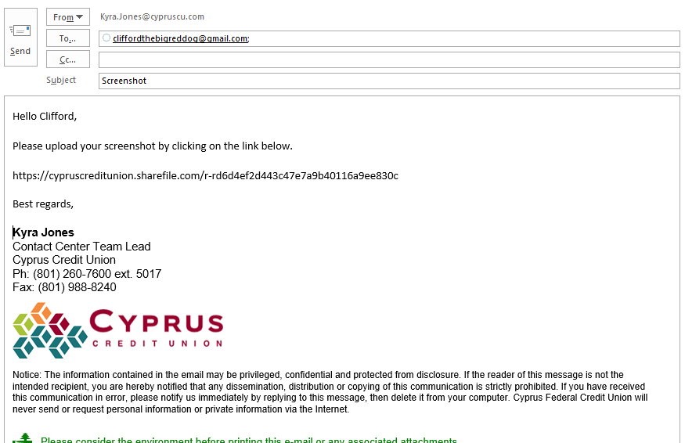
Notes:
It should look something like this.

Slide 22
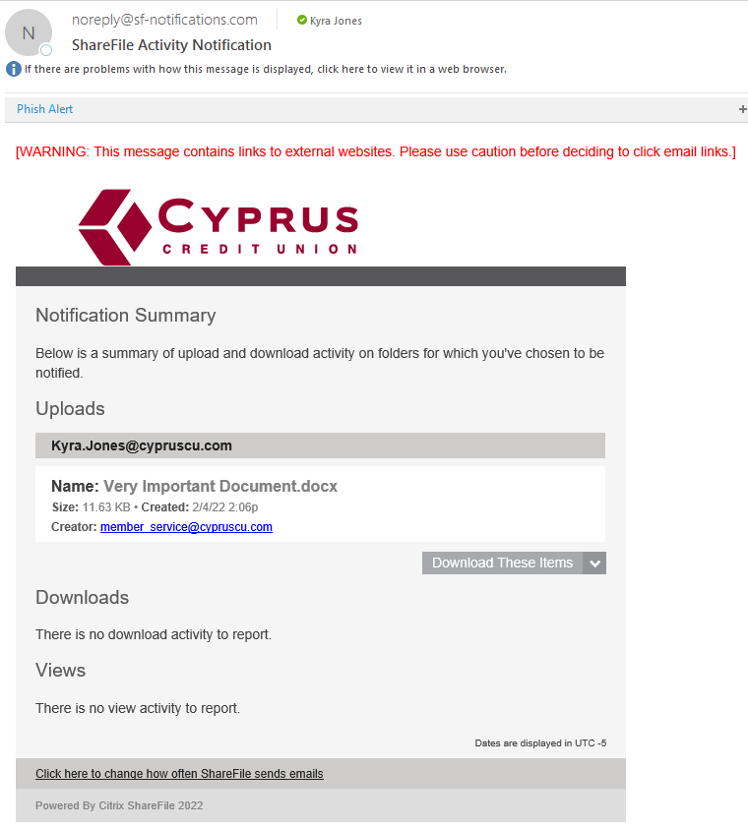
Notes:
As soon as the member hits the “Upload” button, you should receive an email to your Cyprus email such as above. It will tell you what documents were uploaded and there will be a button to download them.
If you click on the “Download These Items” button, it will open the documents in Citrix ShareFile.

Slide 23
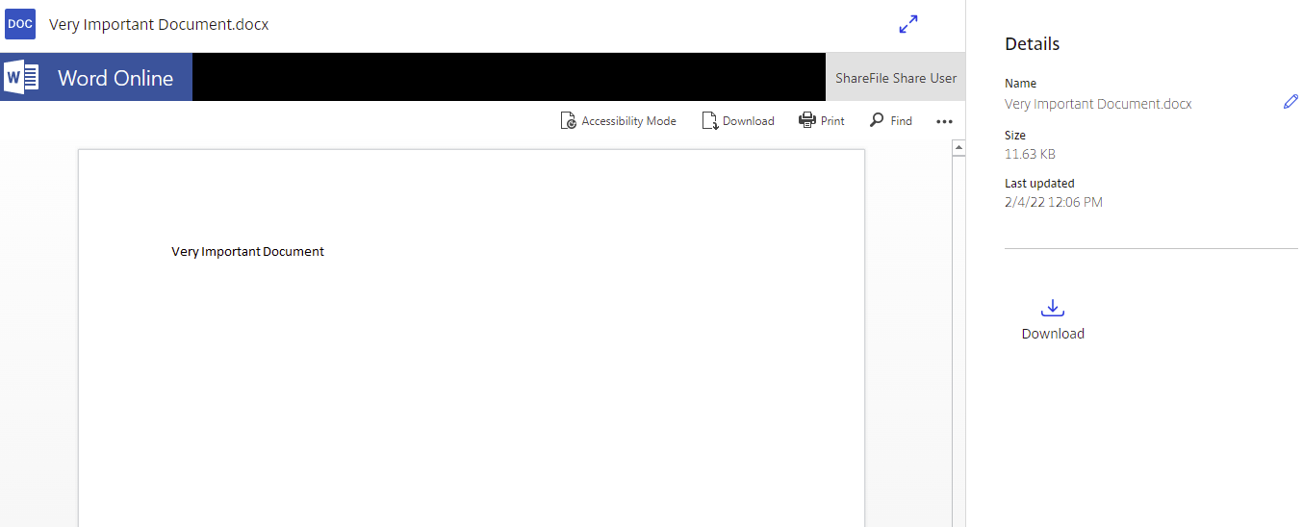
Notes:
If the member sent you a single document, this should open up a preview of the document on Citrix ShareFile.
You can click on the “Download” button either here
Or here to download the document.

Slide 24
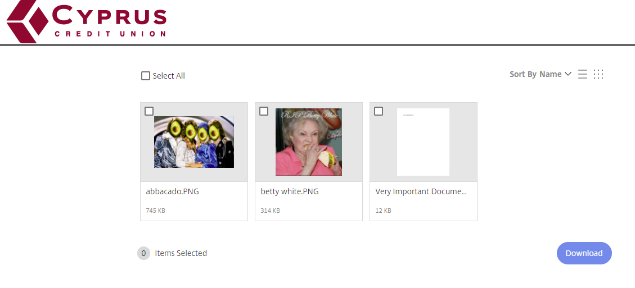
Notes:
If the member has sent multiple documents, you will be able to either select all for download, or choose which of the documents you would like to download.
And please make sure that you are still saving your forms to title apps and blue books for anything that needs to be DocuSigned such as wires!

Slide 25
Here are a couple things that we NEED to request via Citrix ShareFile:
Wire Instructions
Screenshots/official statements from a different institution that show account numbers/balances.
Signed payoff authorizations
Here are a couple things that we can still get via Outlook:
Screenshots of emails/texts that don’t have any sensitive information
Cancellation proof to add to a cardholder dispute

Slide 26
Folders & Inbox!

Slide 27
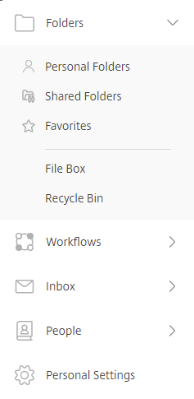
Notes:
Now going back to the dashboard, we are going to briefly talk on how to access and edit your folders.
If you click on the “Folders” tab, it will expand to show a few options.
There is your “Personal Folders”
“Shared Folders”
And “File Box”. All of these are just different folders to save documents in that you are receiving or sending via ShareFile. Please keep in mind that “Shared Folder” is shared amongst everyone in the Contact Center and everyone will receive a notification if you save something in there. Please do NOT save anything in there unless you are specifically told to. Because “File Box” is the default (and probably the one everyone will use the most), we will only talk about that one, but feel free to play around with the other folders if you would like.

Slide 28
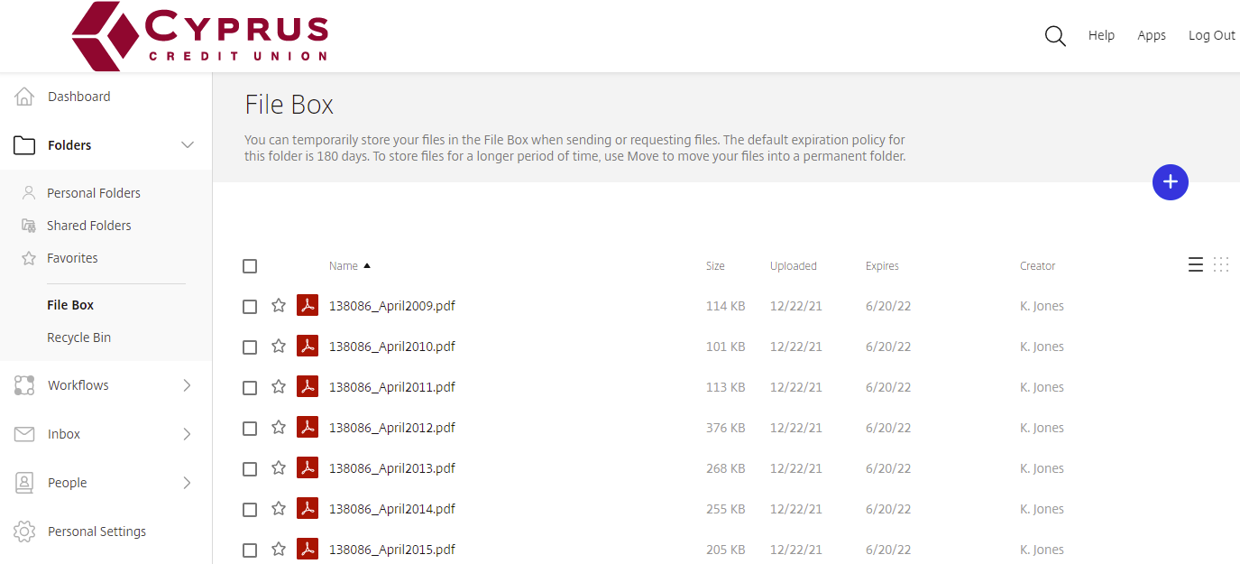
Notes:
This is what the “File Box” looks like. If you haven’t sent anything it will appear empty.
If you decide you need to either view or download one of the saved documents, you will just click on the box next to the name of the document.

Slide 29
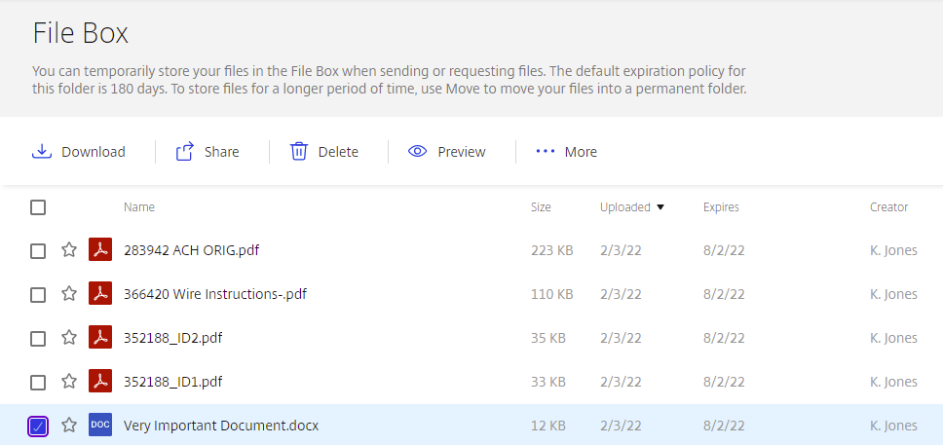
Notes:
Once you have selected a document, various options will show up towards the top of the screen.
You can “Download”,
“Delete”,
or “Preview” the document.

Slide 30
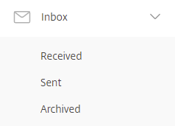
Notes:
Now going back to the dashboard once more, we will quickly go over “Inbox”.
Once you have clicked it, there should be a couple more options. However the only one that you will really need to use is “Sent”
So we will go ahead and talk about that.

Slide 31
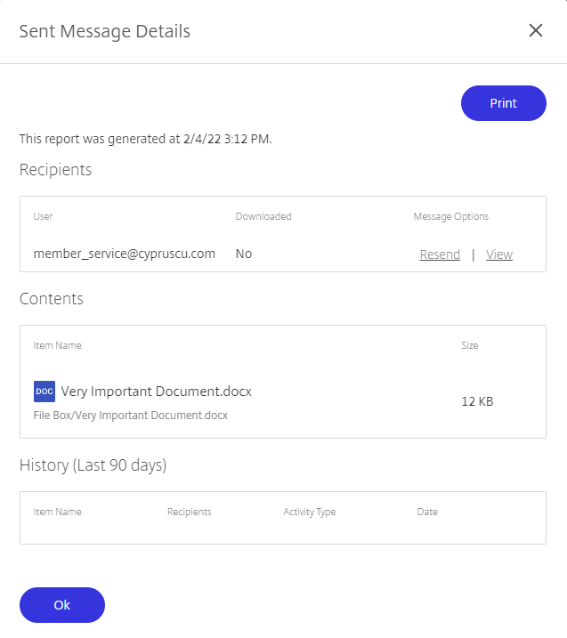
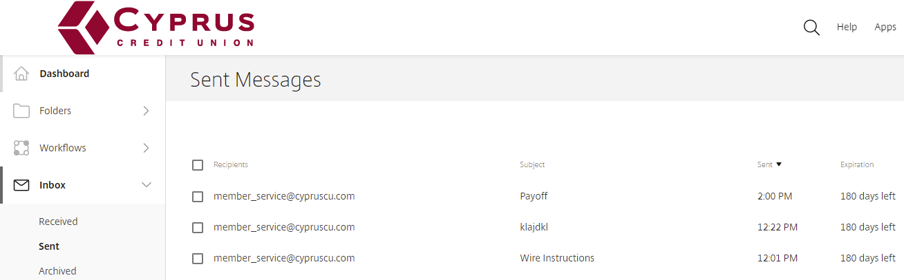
Notes:
This is what your “Sent” tab should look like.
To see the details about the documents you sent, click on the recipients name.
To resend an email, you will click on “Resend” and then fill out the “Subject” and “Message” boxes again before clicking send.

Slide 32
The End!
You should be Citrix ShareFile professionals!! Please don’t hesitate to reach out to the group chat if you need help with using this cool new site!

